Slide 1
Cooperative Collision Warning Using Dedicated Short Range Wireless Communications
Tamer ElBatt, Siddhartha K Goel, Gavin Holland.
Information and System Sciences Laboratory, HRL Laboratories, LLC
Hariharan Krishnan, Jayendra Parikh.
Electrical &Controls Integration Lab, General Motors R&D

Slide 2
Problem Definition
Study the suitability of DSRC (Dedicated Short Range Communications) for a class of vehicular safety applications called Cooperative Collision Warning (CCW)
CCW: vehicles periodically broadcast short messages for the purposes of driver situational awareness and warning.

Slide 3
Application Scenarios
Lane Change Assistance (LCA), where the HV is interested only in messages from the Adjacent Vehicle (AV)
Electronic Emergency Brake Light (EEBL), where the HV is interested in messages from the Next Forward Vehicle (NFV)
Each car is equipped with a GPS device.

Slide 4
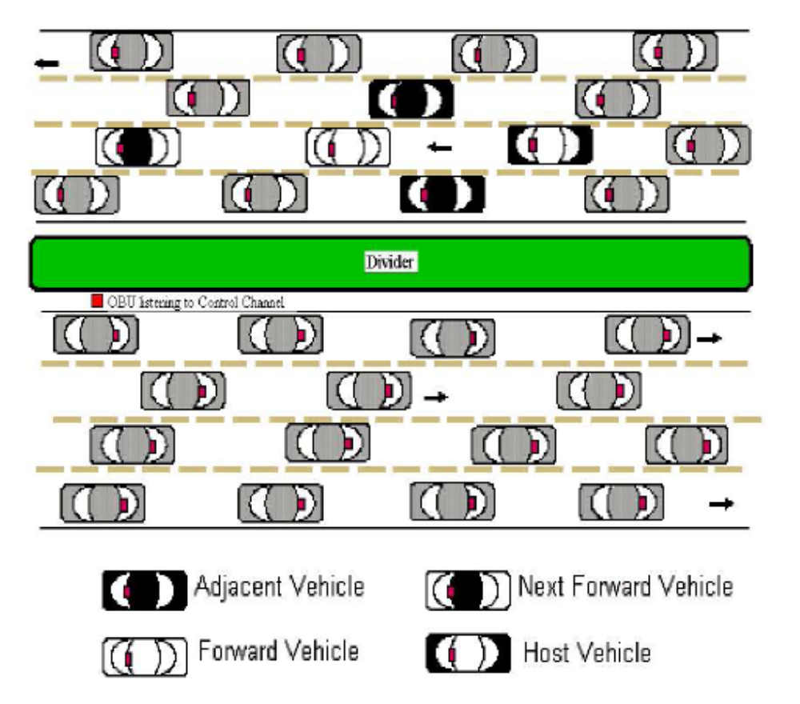

Slide 5
Simulation
Tool: QualNet (contains a 802.11a radio and channel models)
Author modified the packet in accordance with ASTM draft standard.
Simulation time: 30s.
Each vehicle sends 10 packets/sec
Metrics
  Packet inter-reception time (IRT)
  Cumulative number of packet receptions at the HV from a given transmitter

